Slide 1
CLARITY for mapping the nervous system
Kwanghun Chung & Karl Deisseroth
As presented by Daniel Lopez on January 19th, 2016

Slide 2
Summary
CLARITY
Clear Lipid-exchanged Acrylamide-hybridized Rigid Imaging/Immunostaining/In situ hybridization-compatible Tissue-hYdrogel
Makes a clarified brain
In coordination with GFP can reveal:
synapses
Location and types
neuronal populations
Notes:
since Chung is now working with other gel-forming substances beyond acrylamide, the “A” is not always valid. Hence, it’s just CLARITY now.

Slide 3
Opportunity
Brains are complex (in scale and diversity)
Many imaging techniques
Help with extraction of anatomical projection information

Slide 4
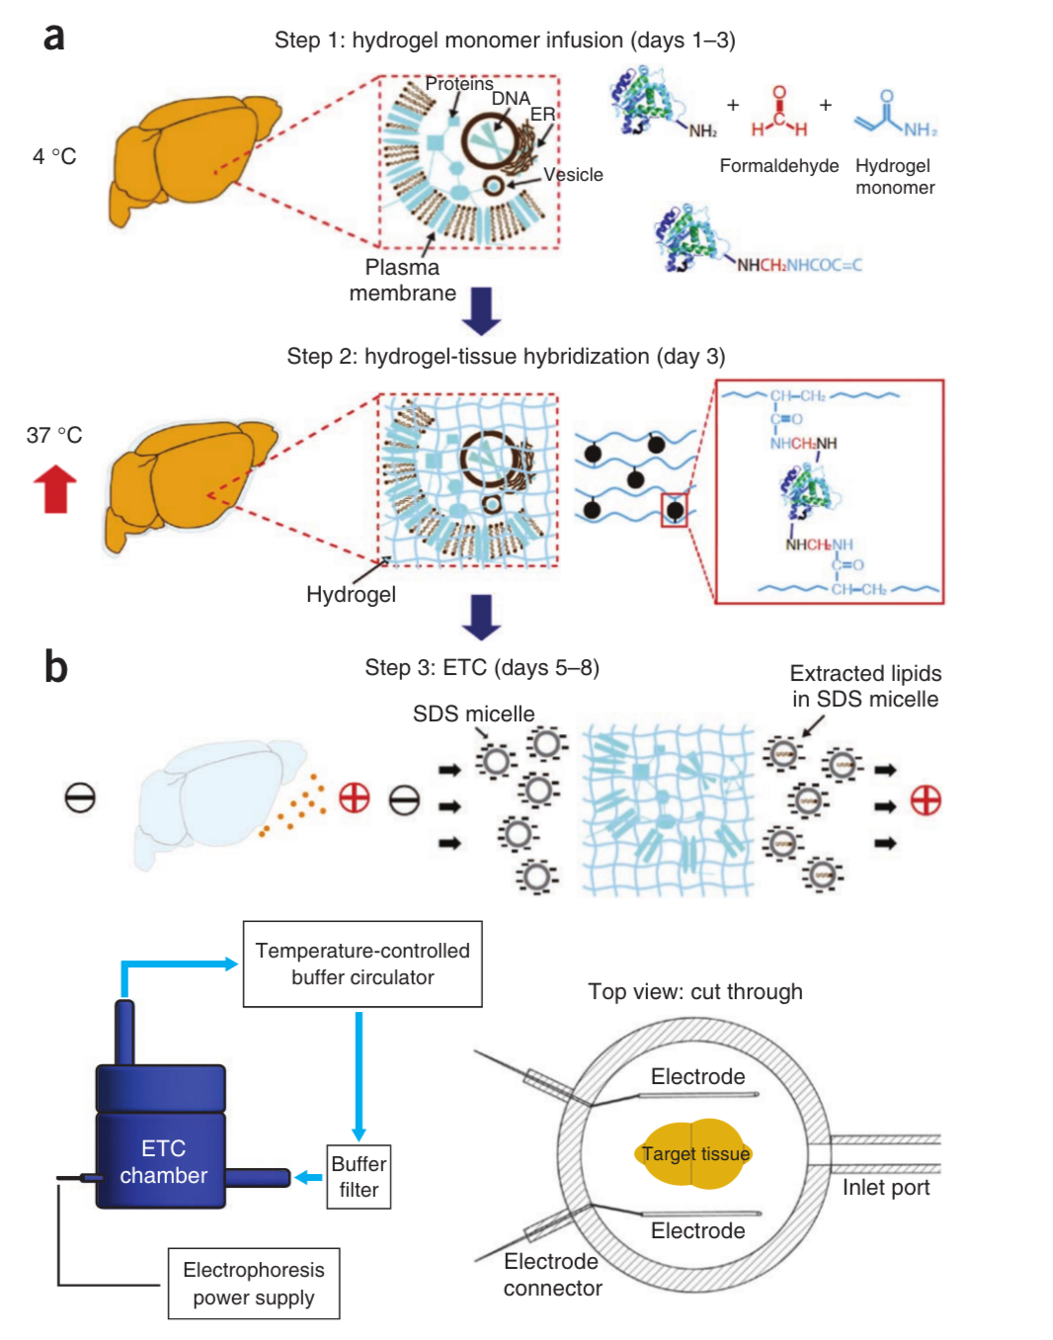
Action
Notes:
cold isolated brain, infuse w/ hydrogel-monomer
Inc temperature => covalent bonding to whatever reacts w/ hydrogel meshwork
Use electric current/electrophoresis to remove lipids,
Resulting in a transparent brain-hydrogel hybrid that both preserves, and makes accessible, structural and molecular information for visualization and analysis.

Slide 5
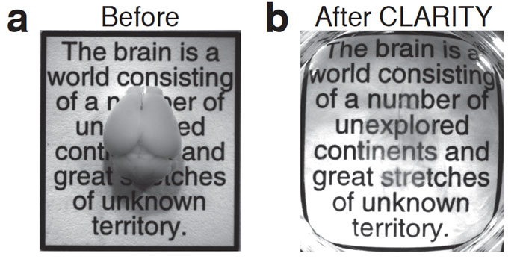
Action
Credit: Kwanghun Chung and Karl Deisseroth, Howard Hughes Medical Institute/Stanford University

Slide 6
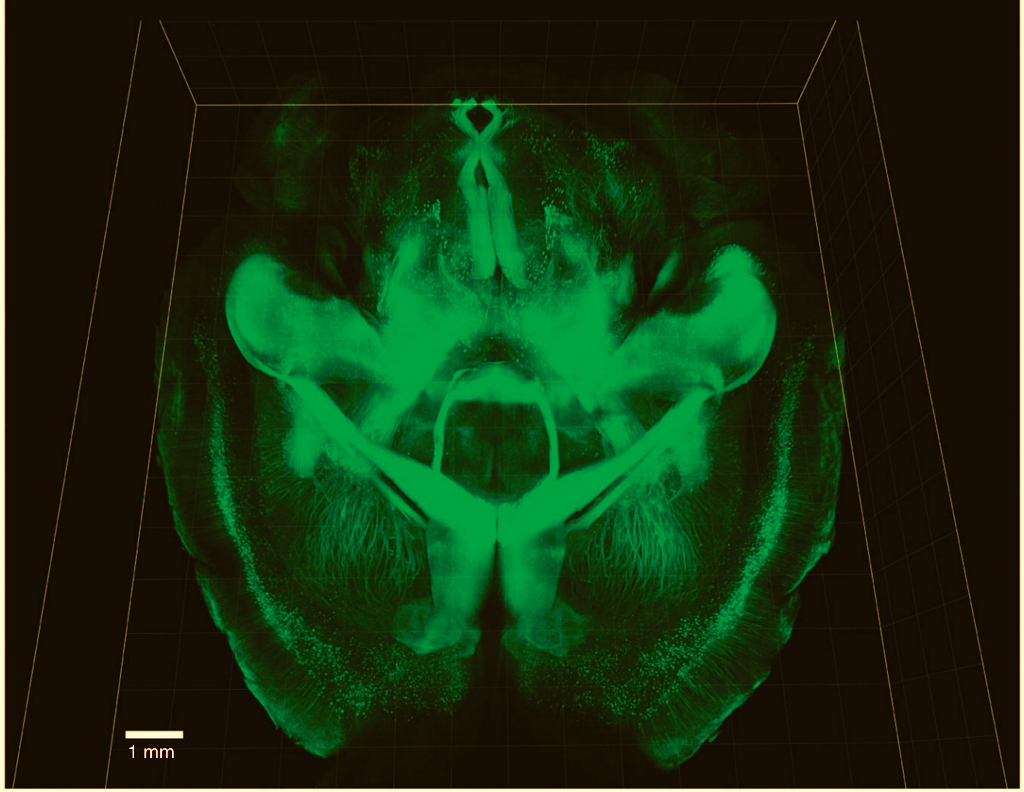
Resolution
Notes:
Imaging of nervous system projections in the intact mouse brain. The clarified mouse brain was imaged from the dorsal region to the ventral region.

Slide 7
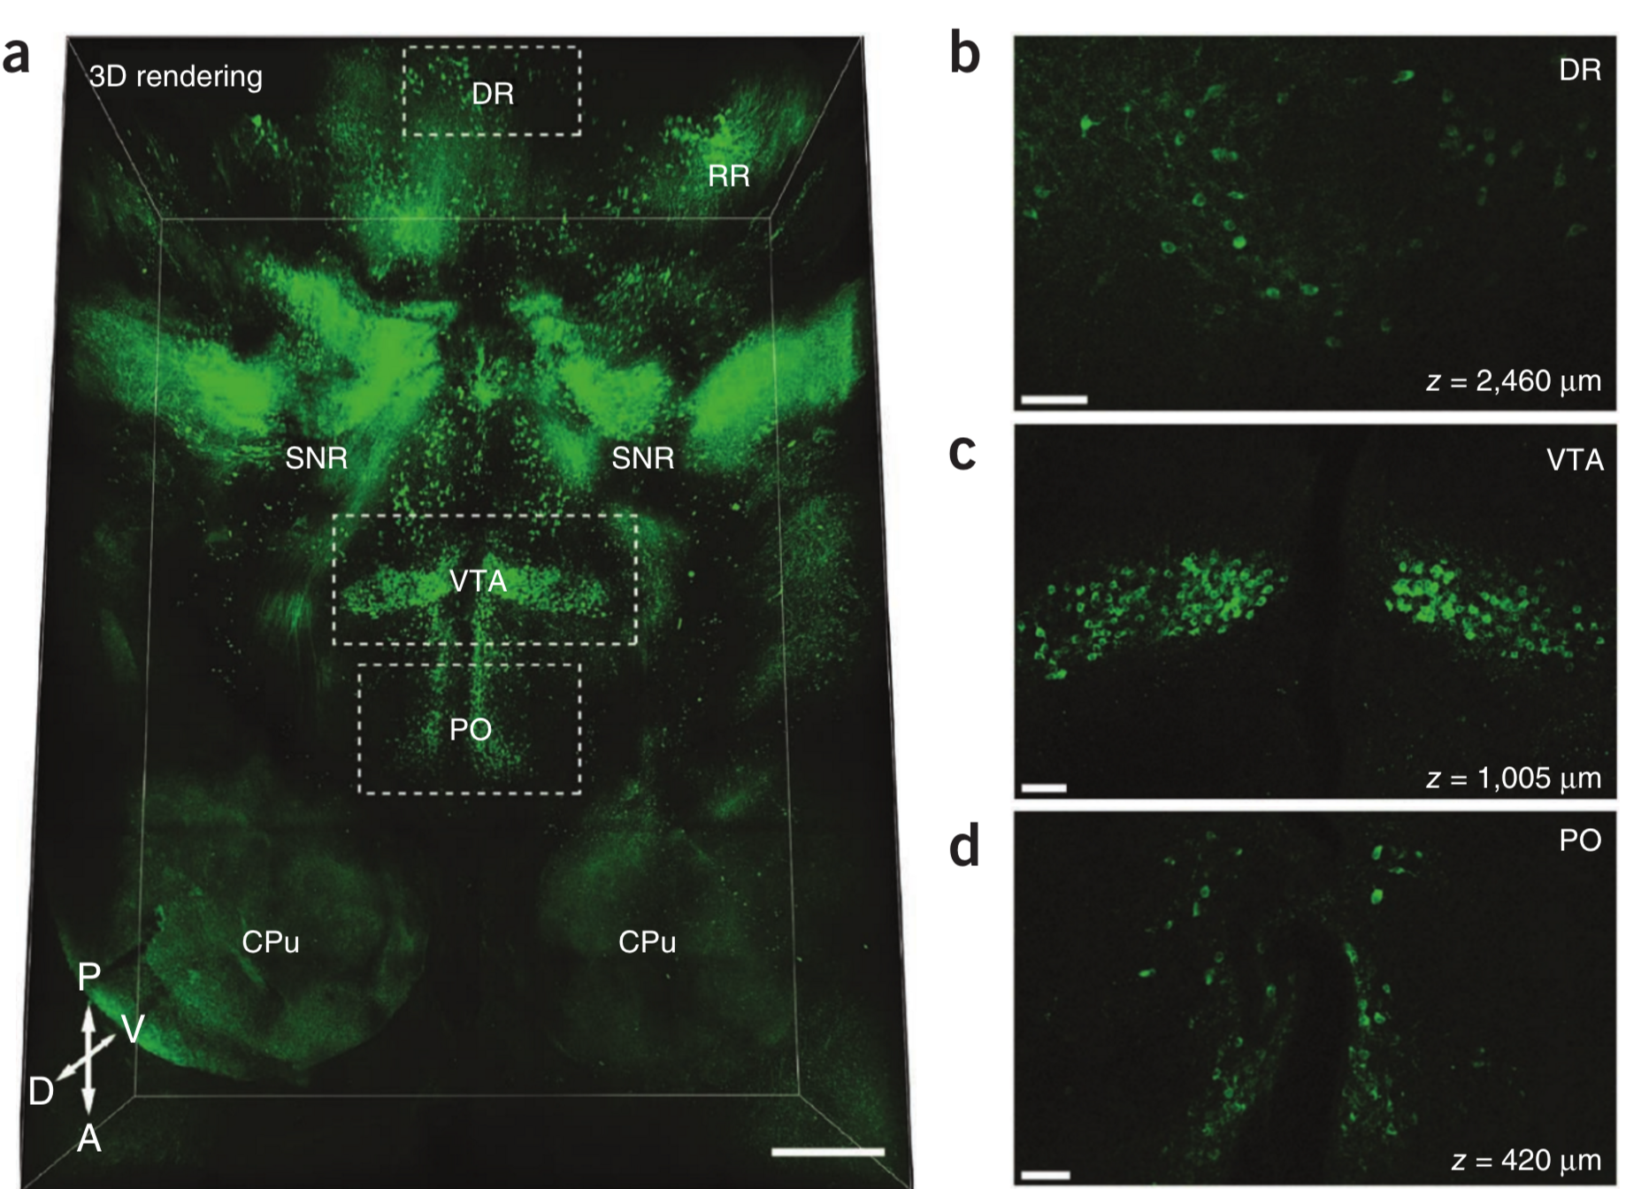
Resolution
Notes:
Three-dimensional (3D) visualization of immunohistology data, showing tyrosine hydroxylase (TH)-positive neurons and fibers in the mouse brain.
DR dorsal raphe; PO preoptic nucleus

Slide 8
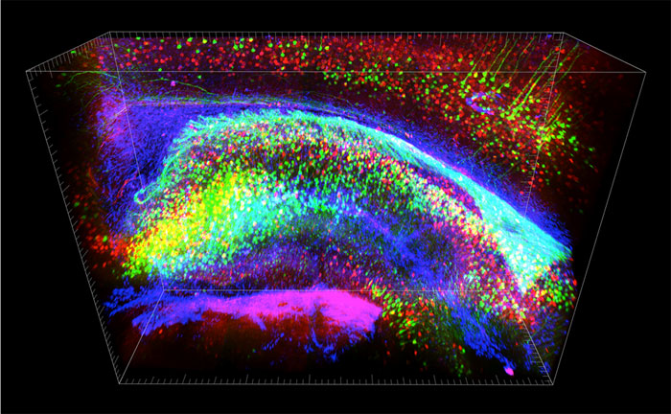
Resolution
Credit: Kwanghun Chung and Karl Deisseroth, Howard Hughes Medical Institute/Stanford University
Notes:
Three-dimensional view of stained hippocampus showing fluorescent-expressing neurons (green), connecting interneurons (red) and supporting glia (blue)
Brainbow - staining process

Slide 9
Resolution
Credit: Kwanghun Chung and Karl Deisseroth, Howard Hughes Medical Institute/Stanford University
Notes:
Double Brainbow

Slide 10
Future
Compatible with EM, staining, and array tomography
Scope goes beyond Neuroscience
Can turn any tissue or organ transparent (e.g. livers, lungs, and hearts)
Clinical applications
Mental Diseases
Possible exploration in pathological states
Cancer, autoimmune disease, etc.
Notes:
Help w/ understanding b/w cells and tissues or organs

Slide 11
Discussion
Pros
Application beyond Neuroscience
Image intact brain with high resolution
Less slicing
Cons
Prototype (innovation needed)
Tricky technique
Time
Notes:
Chung burned/melted 100s of brains to get tech right
-notes on how to do it online tho
About 8% of total protein content is lost in CLARITY vs ~24% for other methods w/ conventional histological solution compositions
-need to investigate loss
Anything that doesn’t react w/ the gel gets lost
Don’t know how long clarified tissue may be maintained or stored for testing ( analysis, imaging, etc. for processing)

